Slide 1
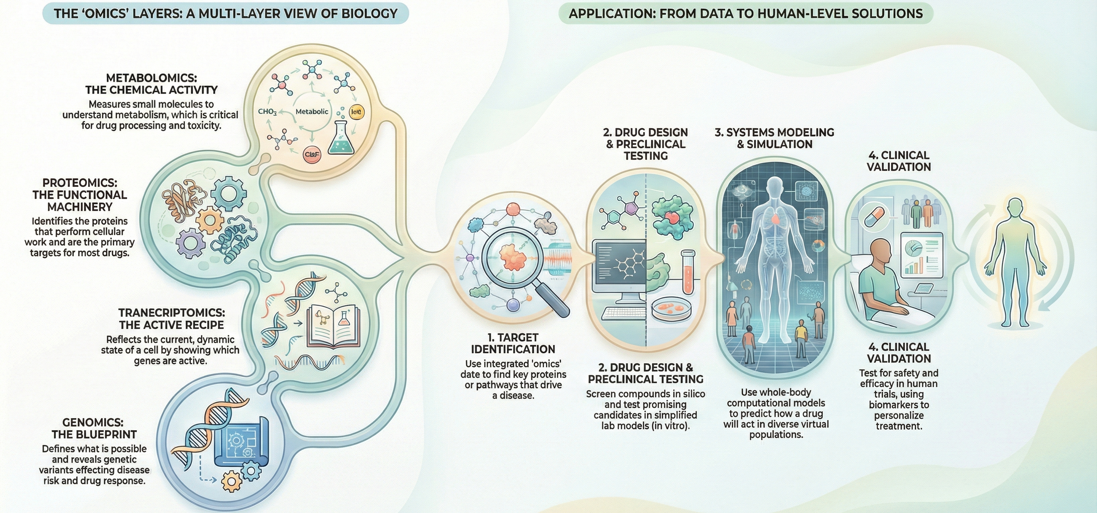

Bioinf & medicine
Paweł Dąbrowski-Tumański
MiNI Final Lecture, Still Winter 2026

Slide 3

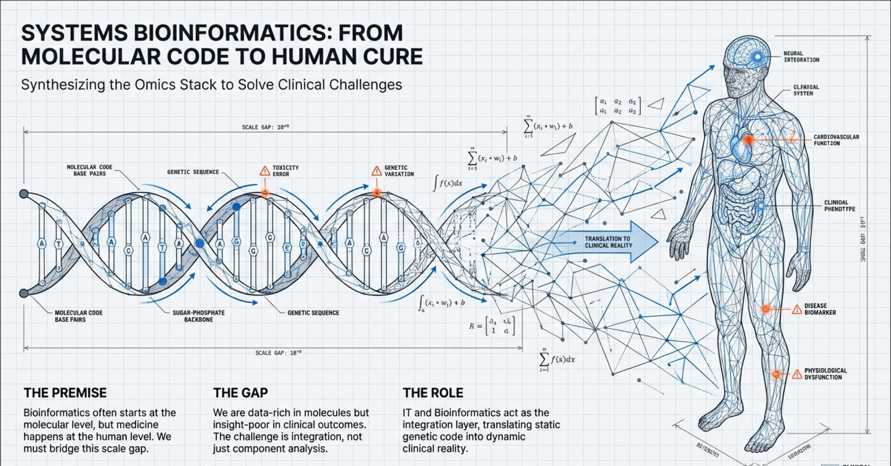





FROM MOLECULES TO MEDICINE

Slide 4
FROM MOLECULES TO MEDICINE
🔬 Bioinformatics often starts at molecules
🧬 Medicine happens at the human level
🏥 Clinics connect biology to real decisions
🧠 Today we zoom out

Slide 5
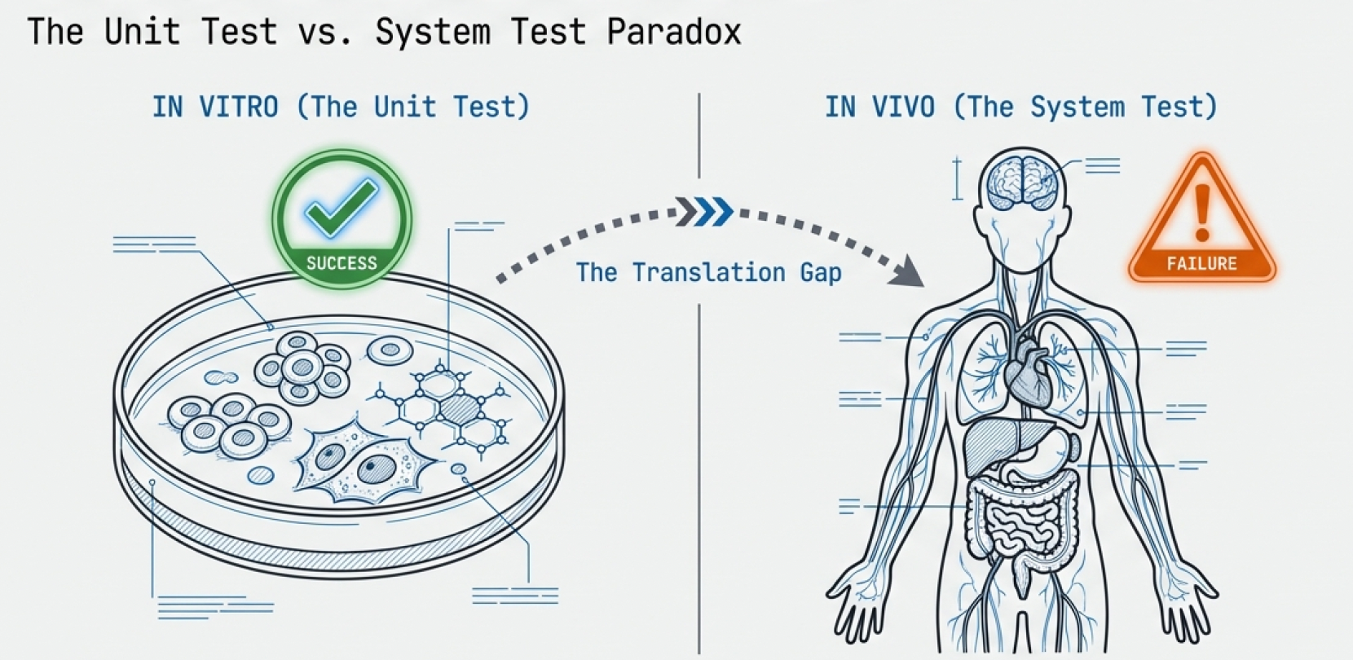
UNDERSTANDING CELLS IS NOT ENOUGH

Slide 6
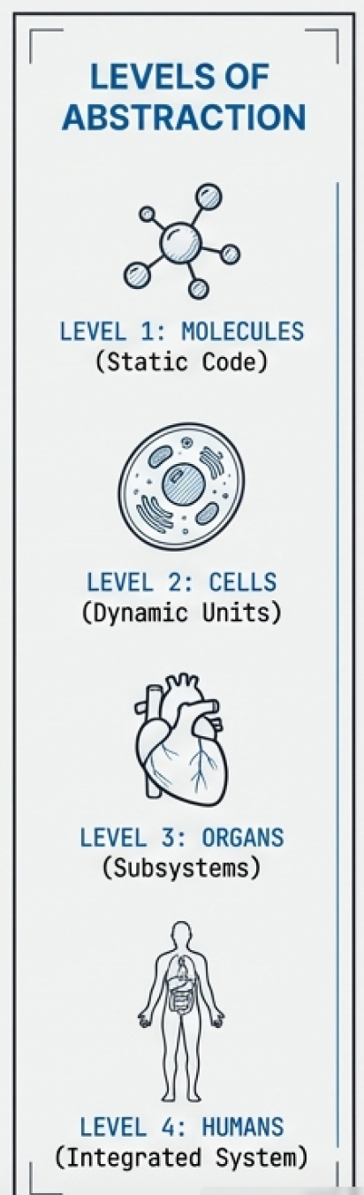
UNDERSTANDING CELLS IS NOT ENOUGH
🧫 Cells do not live in isolation
🔄 Interactions create unexpected behavior
⚠️ Many drugs fail despite cellular success
🧩 Context changes outcomes

Slide 7
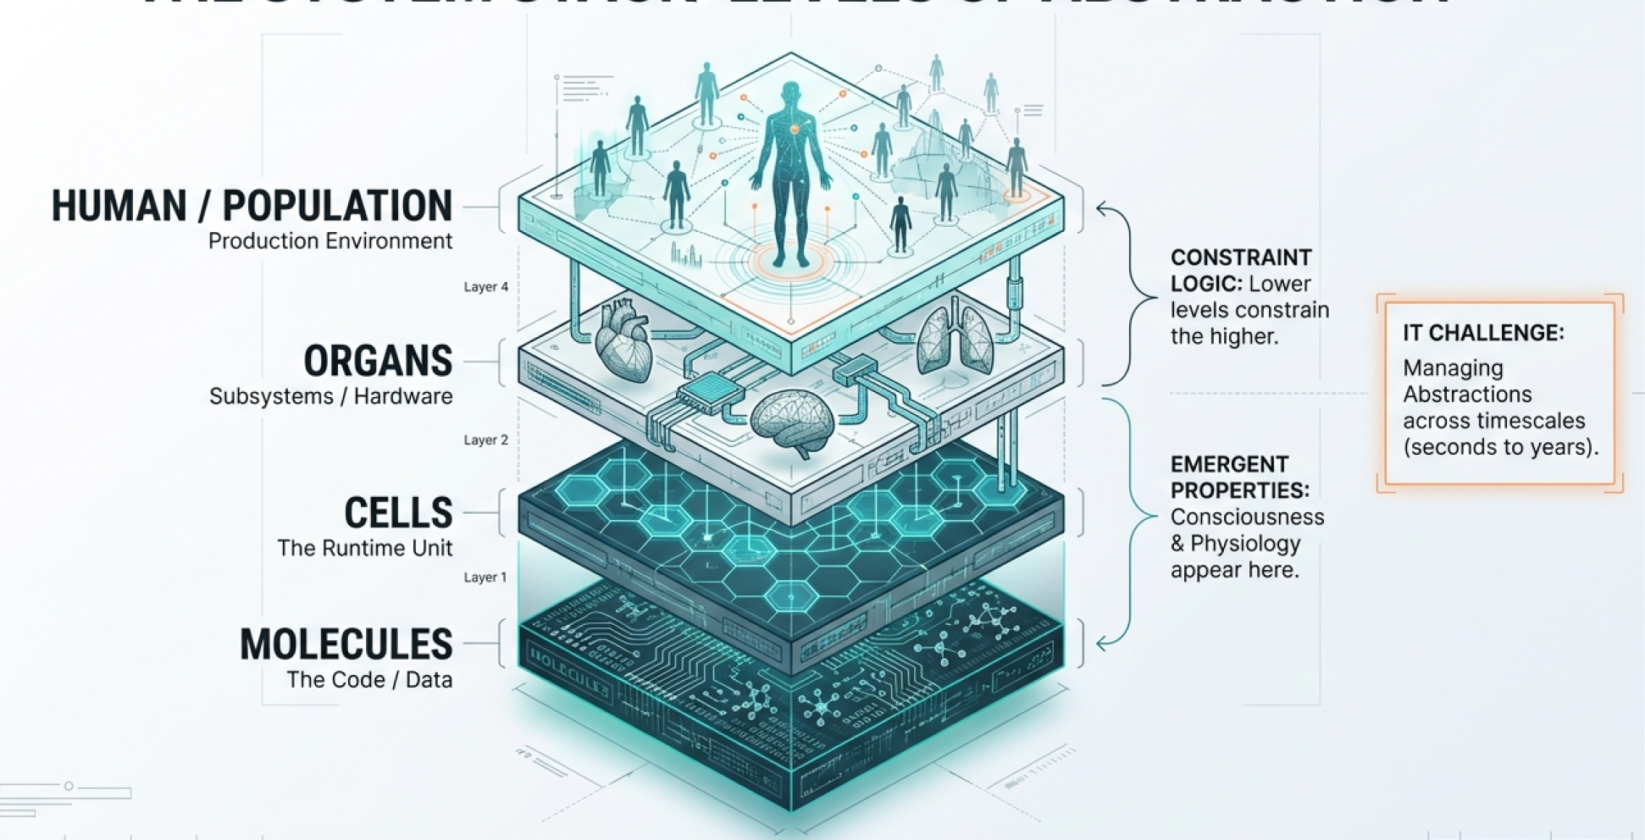
LEVELS OF ABSTRACTION

Slide 8
LEVELS OF ABSTRACTION
📐 Each level needs its own models
🔗 Lower levels constrain higher ones
📊 Data types change across levels
🧠 IT excels at managing abstractions

Slide 9
CELLS AS INTERACTING SYSTEMS
⚙️ Cells are not static machines
🔁 Continuous signal processing
🧩 Multiple subsystems interact
📈 Behavior changes over time

Slide 10
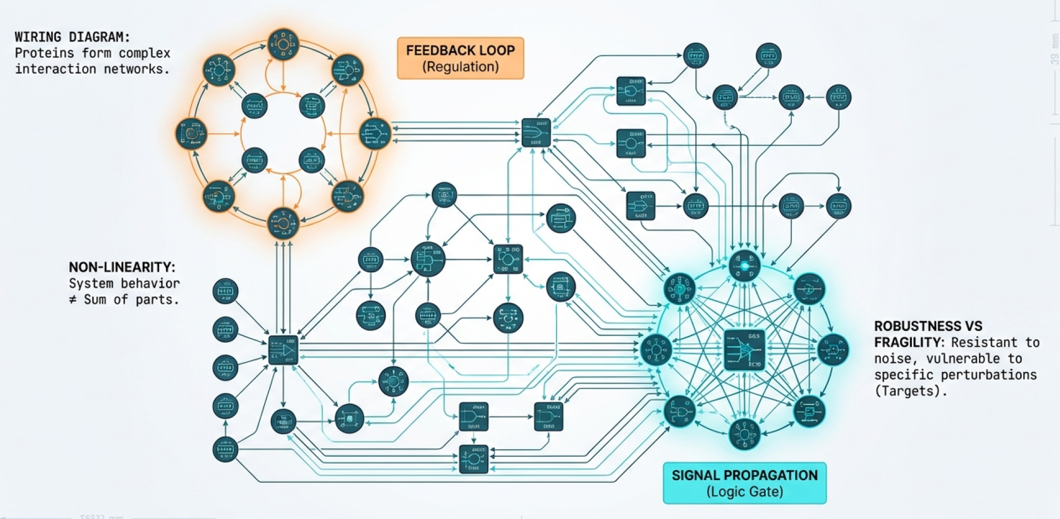
PATHWAYS, NETWORKS, AND LOOPS

Slide 11
PATHWAYS, NETWORKS, AND LOOPS
🕸️ Proteins form interaction networks
🔄 Feedback loops regulate behavior
🚦 Pathways cross and interfere
🧠 Networks explain nonlinearity

Slide 12
EMERGENCE, ROBUSTNESS, FRAGILITY
✨ System behavior ≠ sum of parts
🛡️ Robust to noise and small changes
💥 Fragile to specific perturbations
⚠️ Drugs exploit fragility

Slide 13
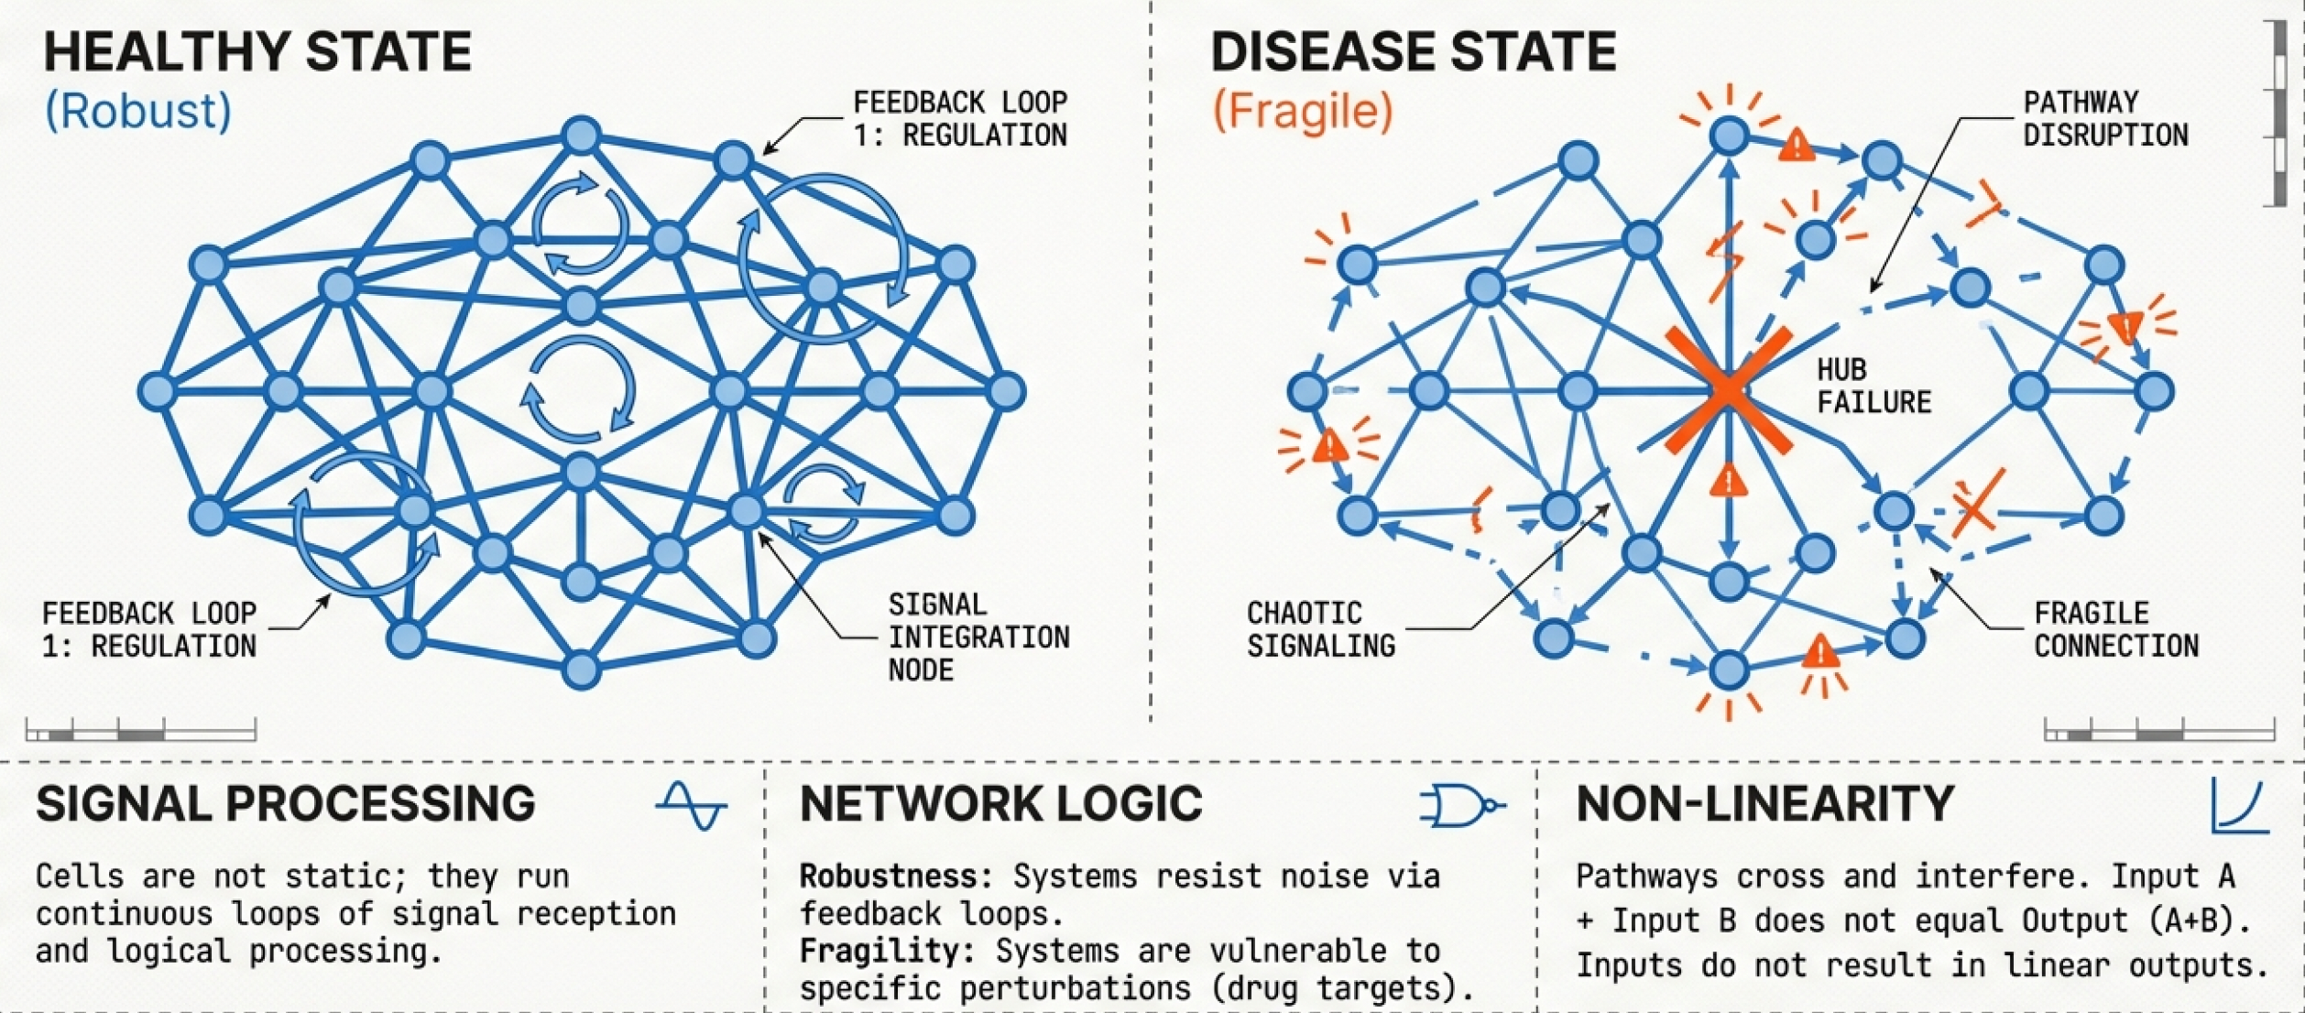
DISEASE - SYSTEM MISCONFIGURATION

Slide 14
DISEASE - SYSTEM MISCONFIGURATION
🧩 Rarely a single broken component
🔀 Altered network states
📉 Loss of regulation and balance
🎯 Drugs aim to reconfigure systems

Slide 15
TIME, SPACE, AND CONTEXT
⏱️ Timing matters for signaling
📍 Location changes function
🧠 Same cell, different context
⚠️ Snapshots miss dynamics

Slide 16
GENOME
🧬 Genome defines what is possible
🧠 Mostly static across lifetime
🔀 Variants affect risk and response
👥 Differences matter clinically

Slide 17
TRANSCRIPTOME
📊 Reflects current cell conditions
⏱️ Changes rapidly over time
🧠 Sensitive to environment
⚠️ Not equal to protein levels

Slide 18
PROTEOME
⚙️ Proteins perform cellular work
🔄 Modified post-translationally
📍 Localization matters
🎯 Most drugs target proteins

Slide 19
INTERACTOME
🕸️ Defines who talks to whom
🔄 Enables signal propagation
⚠️ Incomplete and context-dependent
🧠 Graphs capture system logic

Slide 20
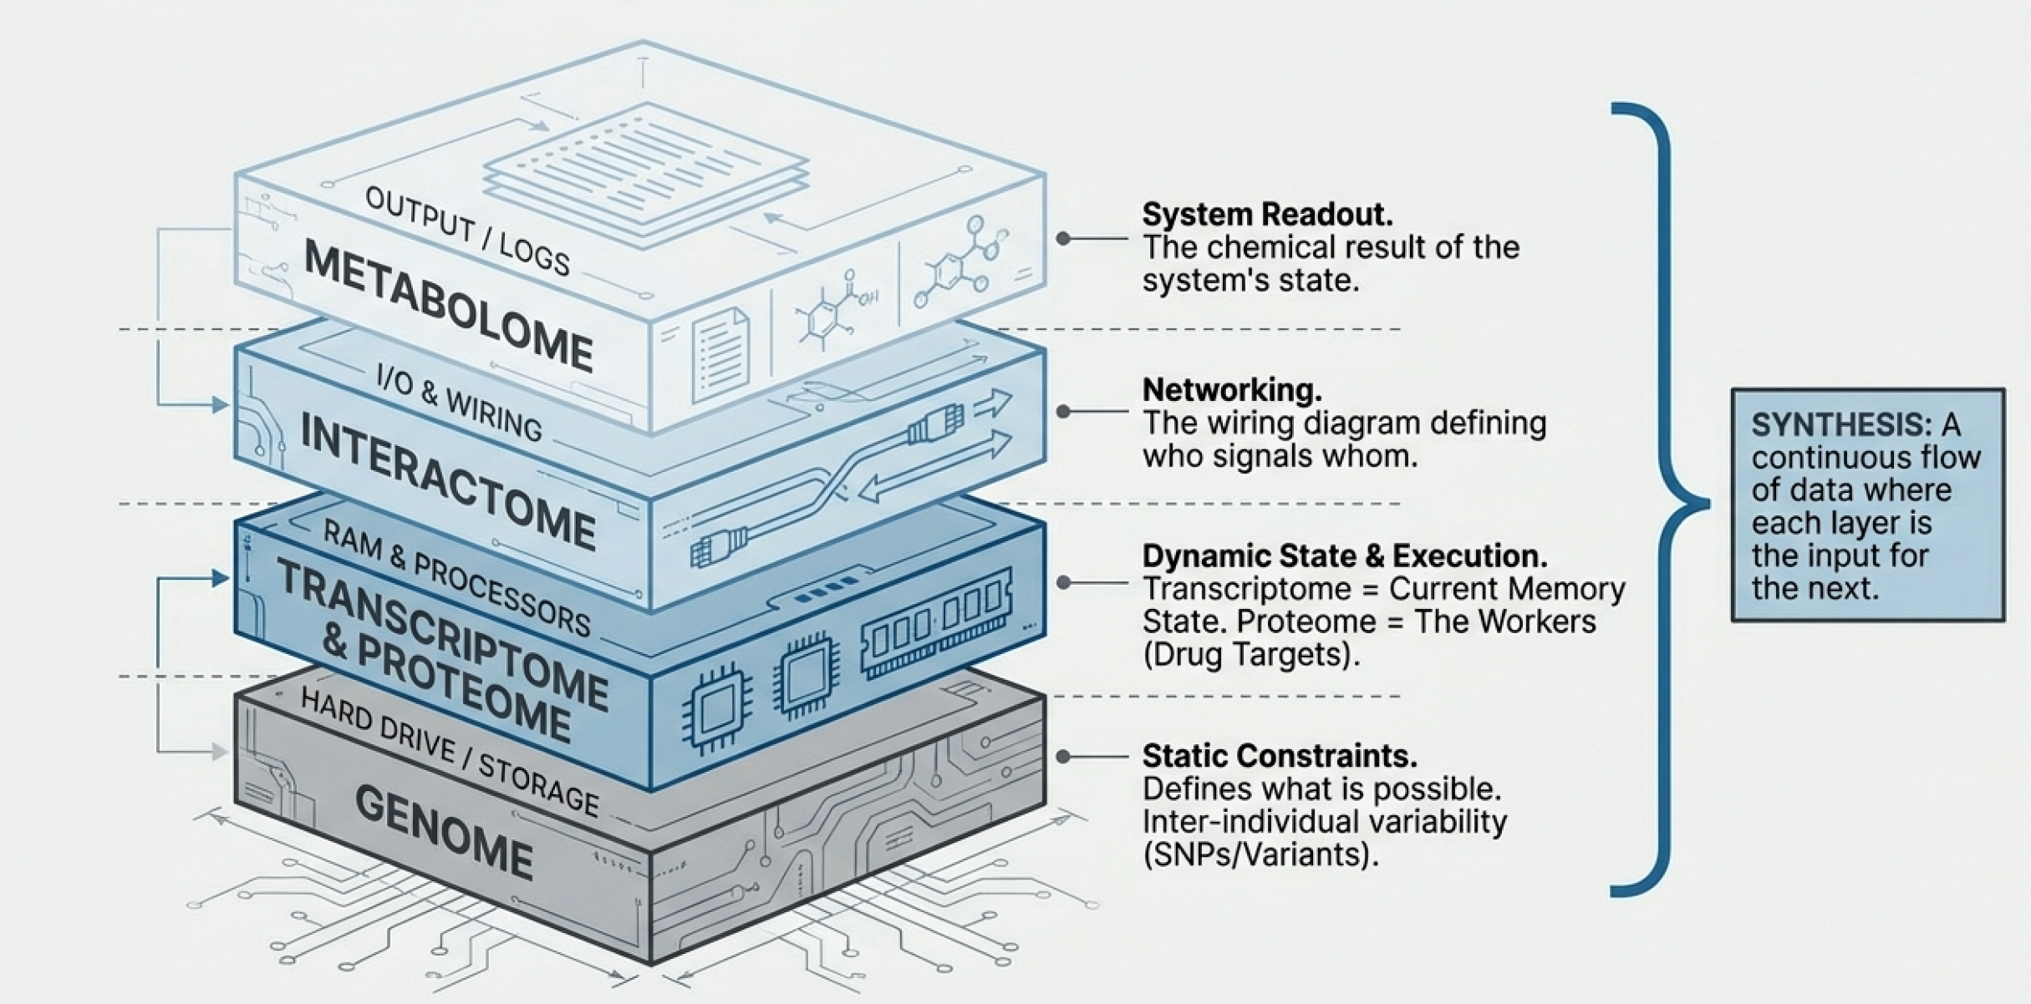
MULTI-OMICS INTEGRATION

Slide 21
MULTI-OMICS INTEGRATION
🧩 Each omics is a partial view
📊 Integration reveals system state
⏱️ Adds temporal complexity
🧠 IT enables data fusion

Slide 22
MULTI-OMICS INTEGRATION OFTEN FAILS
❌ Different scales and noise
📉 Missing and biased data
🔀 Correlation without causation
🧠 Models matter more than volume

Slide 23
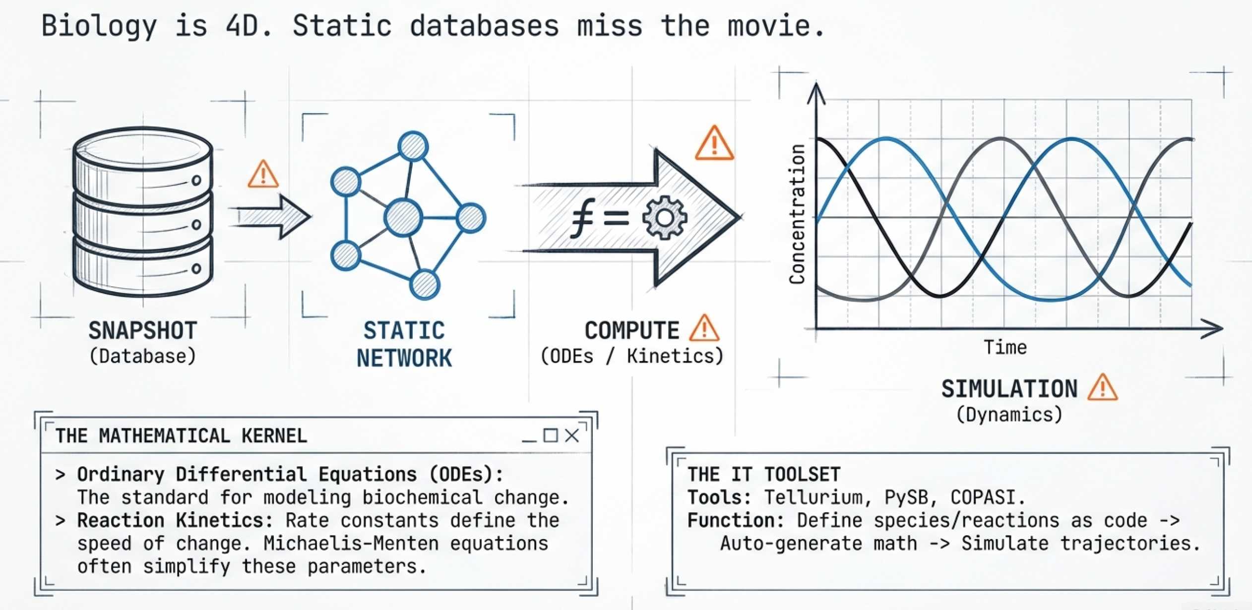
MULTI-OMICS INTEGRATION OFTEN FAILS

Slide 24
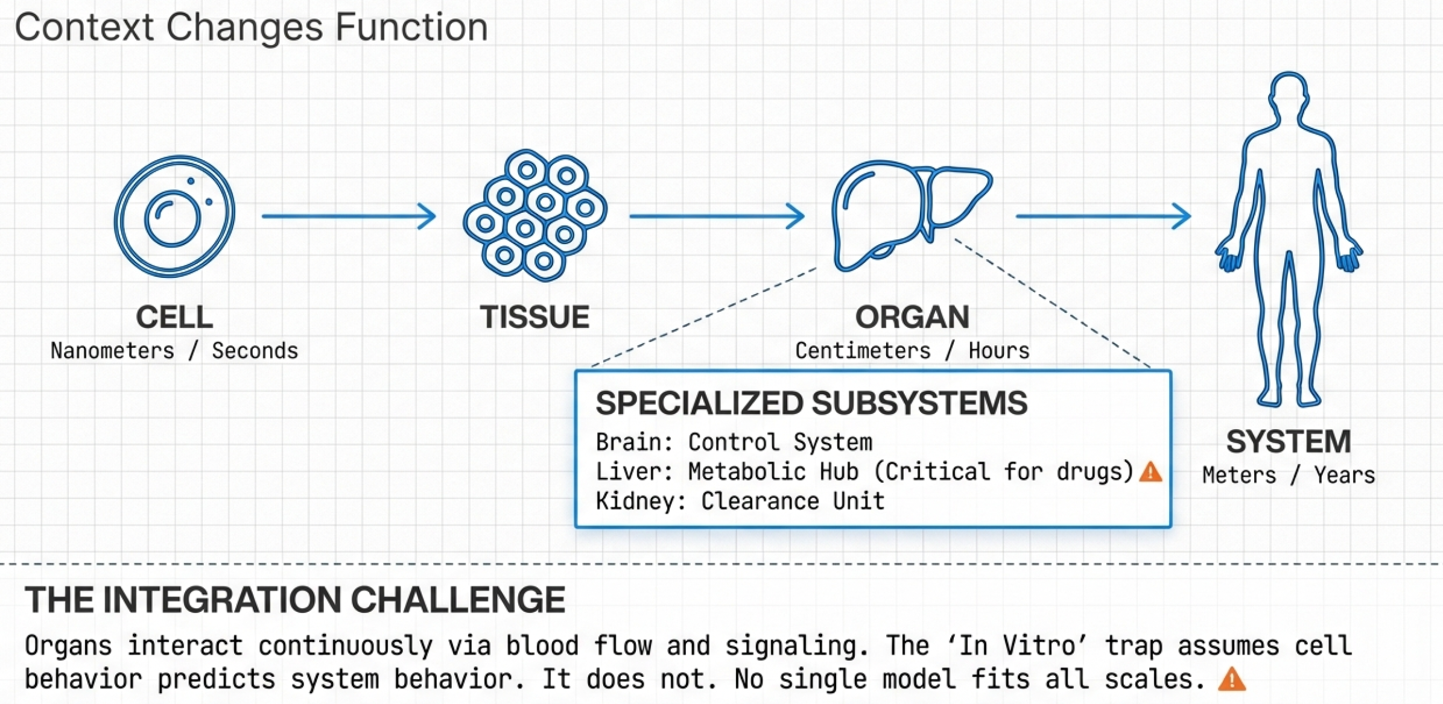
FROM CELLS TO TISSUES AND ORGANS

Slide 25
FROM CELLS TO TISSUES AND ORGANS
🧫 Cells specialize and cooperate
🏗️ Structure affects function
🔄 Signals cross tissue boundaries
⚠️ Scaling is non-trivial

Slide 26
ORGANS AS SPECIALIZED SUBSYSTEMS
🧠 Brain as control system
🧪 Liver as metabolic hub
🚰 Kidneys as clearance units
🔗 Organs interact continuously

Slide 27
CROSS-SCALE MODELING
⏱️ Seconds to years
📏 Nanometers to meters
🧠 No single model fits all
⚠️ Approximation is unavoidable

Slide 28
BIOLOGICAL MEMORY
🧠 Immune system remembers
🔁 Organs adapt structurally
⚠️ Prior disease alters drug response
📊 History matters in prediction

Slide 29
DRUG–DRUG INTERACTIONS
💊 Drugs rarely act alone
🔄 Shared pathways cause interference
🧪 Liver metabolism is a hotspot
⚠️ Effects emerge at system level

Slide 30

CLINICAL NEED TO BIOLOGICAL HYPOTHESIS
🏥 Start from unmet medical need
🧠 Translate symptoms to biology
🎯 Define what should be perturbed
⚠️ Wrong hypothesis → guaranteed failure

Slide 31
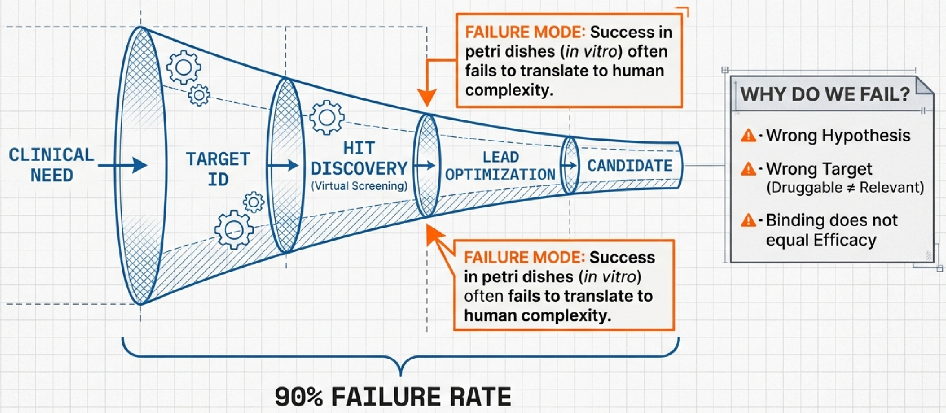
CLINICAL NEED TO BIOLOGICAL HYPOTHESIS

Slide 32
TARGET IDENTIFICATION
🕸️ Pathways highlight control points
🎯 Targets are usually proteins
📊 Data-driven target discovery
⚠️ Druggable ≠ relevant

Slide 33
TARGET VALIDATION
🧬 Genetics supports causality
📊 Expression links targets to disease
🕸️ Network position matters
⚠️ Correlation is not validation

Slide 34
HIT DISCOVERY
🧪 Screen millions of compounds in silico
🧠 Structure guides candidate selection
📉 Reduce experimental cost
⚠️ Binding ≠ efficacy

Slide 35
HIT-TO-LEAD OPTIMIZATION
🔧 Improve potency and selectivity
⚖️ Balance activity and safety
🧪 Iterate chemistry and testing
📉 Many hits are discarded

Slide 36
IN VITRO MODELS
🧫 Fast and controllable experiments
📉 Reduced biological complexity
🎯 Good for mechanism testing
⚠️ Poor at predicting humans

Slide 37
WHEN SUCCESS DOES NOT TRANSLATE
❌ Missing metabolism and clearance
🔄 No organ–organ interactions
🧠 Simplified system behavior
⚠️ Many failures start here

Slide 38
WHY WHOLE-BODY MODELS ARE NEEDED
🧍 Humans are multi-organ systems
💊 Drugs move and transform
⚠️ Cell-level models are insufficient
🧠 Systems need systems models

Slide 39
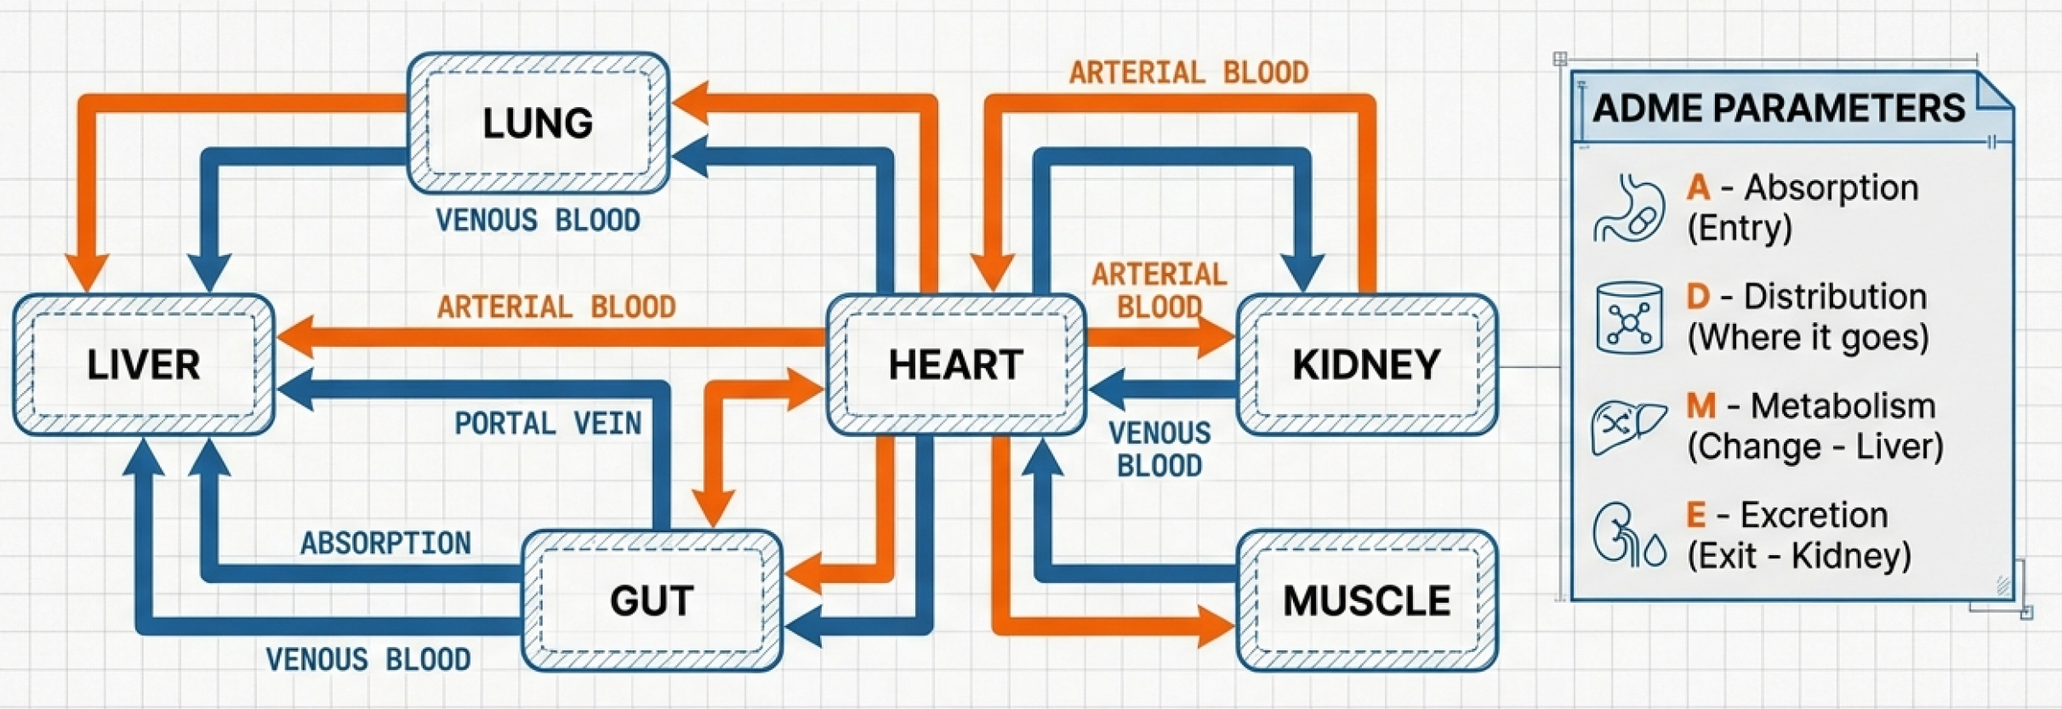
WHY WHOLE-BODY MODELS ARE NEEDED

Slide 40
HUMANS AS COMPARTMENTS
🧠 Organs modeled as compartments
🔄 Blood flow connects them
📐 Based on physiology
⚙️ Solved using ODEs

Slide 41
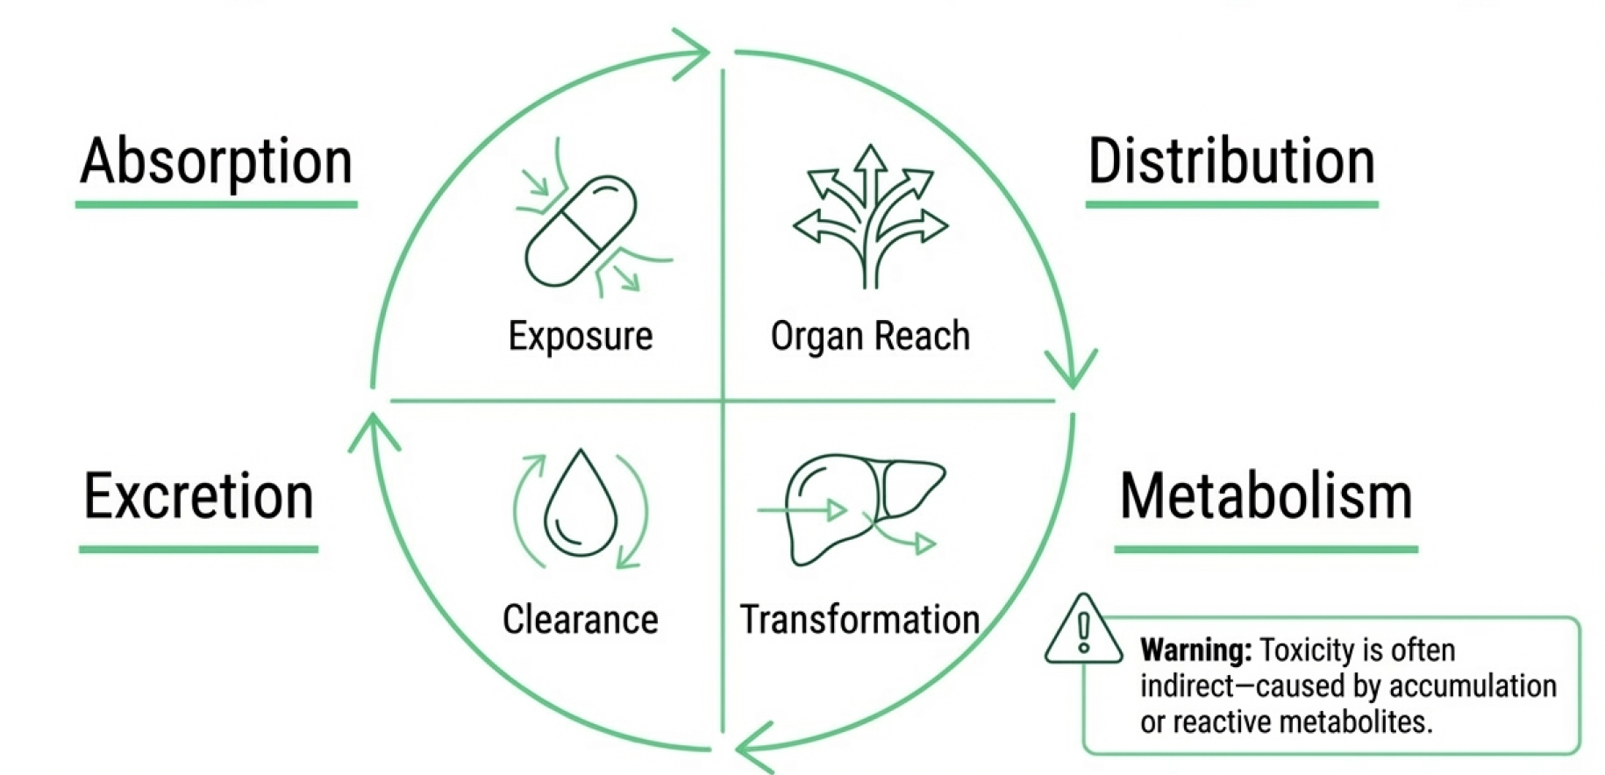
ADME PREDICTION BEYOND THE CELL

Slide 42
ADME PREDICTION BEYOND THE CELL
➡️ Absorption affects exposure
🧪 Distribution defines reach
🧬 Metabolism transforms drugs
🚰 Excretion removes compounds

Slide 43
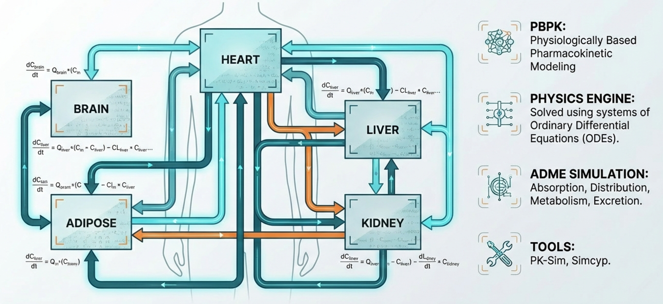
PK-SIM, SIMCYP, MOBI

Slide 44
PK-SIM, SIMCYP, MOBI
🛠️ Industry-standard PBPK tools
📊 Parameterized by physiology
👥 Enable virtual populations
⚠️ Still model-dependent

Slide 45
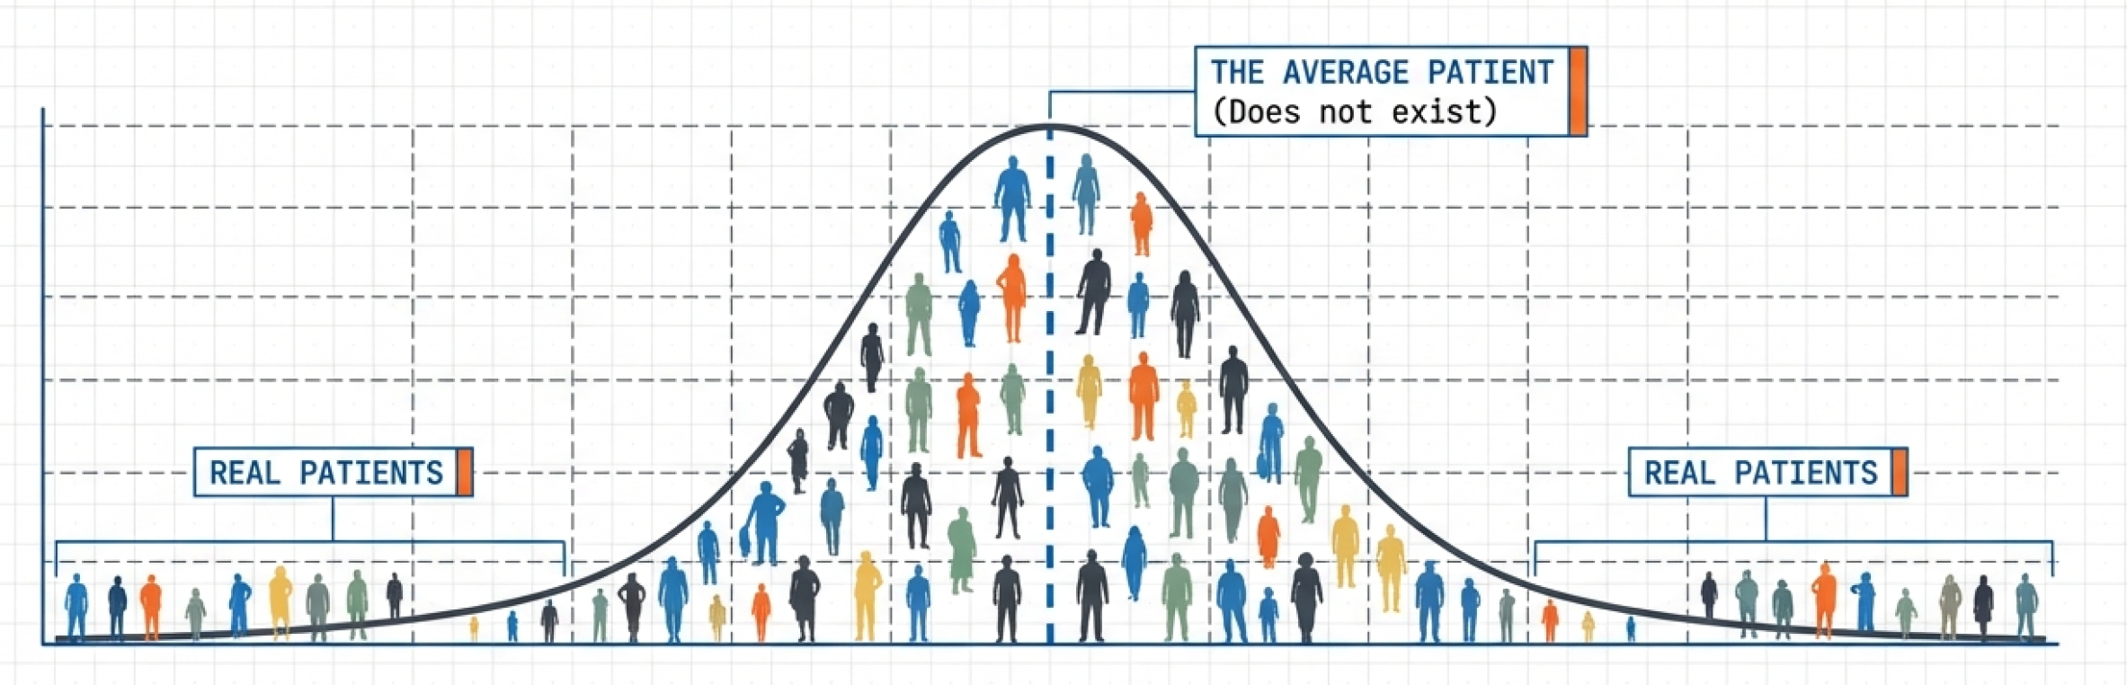
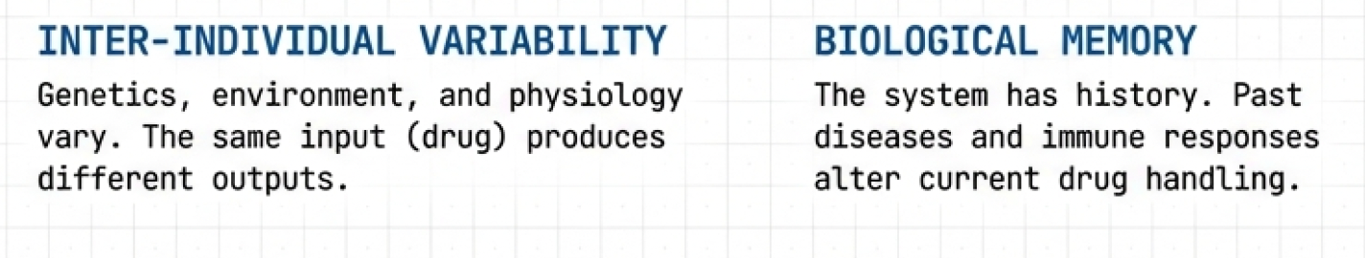
VIRTUAL POPULATIONS

Slide 46
VIRTUAL POPULATIONS
👥 People differ biologically
📊 Simulate distributions, not averages
⚖️ Identify high-risk subgroups
🧠 Personalization starts here

Slide 47
PROLONGED AND DELAYED DRUG EFFECTS
⏱️ Effects appear after long exposure
🔄 Accumulation changes dynamics
🧬 Indirect pathway activation
⚠️ Hard to detect early

Slide 48
WHEN TOXICITY IS INDIRECT
☠️ Not caused by direct binding
🧪 Metabolites may be toxic
🕸️ Network effects accumulate
⚠️ Late-stage failure risk

Slide 49
MODELING BIOCHEMICAL NETWORKS
📐 Reactions modeled mathematically
🔄 Concentrations change over time
⚙️ Deterministic system behavior
🧠 Core of mechanistic modeling

Slide 50
ENZYMATIC NETWORKS
⚗️ Rate constants define dynamics
🧪 Michaelis–Menten is a simplification
🔄 Multiple reactions interact
⚠️ Parameters are often uncertain

Slide 51
PYTHON TOOLS: TELLURIUM, PYSB, COPASI
🐍 Define species and reactions as code
📐 Automatic ODE generation
📊 Simulate and analyze dynamics
🧠 IT-friendly biology modeling

Slide 52
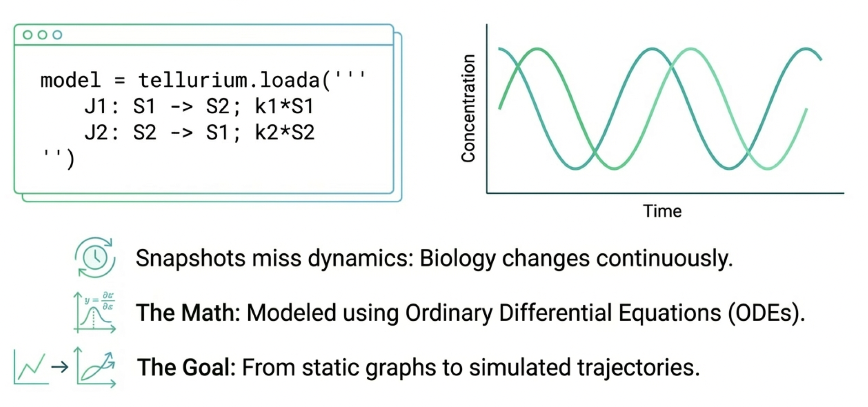
PYTHON TOOLS: TELLURIUM, PYSB, COPASI

Slide 53
REACTION GRAPHS & SIMULATED DYNAMICS
🕸️ Graphs encode interactions
📐 Equations encode behavior
📊 Simulations reveal trajectories
⚠️ Structure ≠ dynamics

Slide 54
CELLULAR DYNAMICS & PBPK MODELS
🔗 Cellular models feed organ models
⚙️ PBPK provides systemic context
🧠 Multi-scale integration is key
🚀 Toward predictive medicine

Slide 55

PRECLINICAL STUDIES AS RISK REDUCTION
🛡️ Goal is to reduce clinical risk
🧪 Combine in vitro and in vivo data
📉 Filter out unsafe candidates early
⚠️ Not proof of human efficacy

Slide 56
IN VIVO STUDIES AND ANIMAL MODELS
🐭 Whole-organism experiments
🧠 Capture systemic interactions
🧪 Assess PK and toxicity
⚠️ Species differences matter

Slide 57
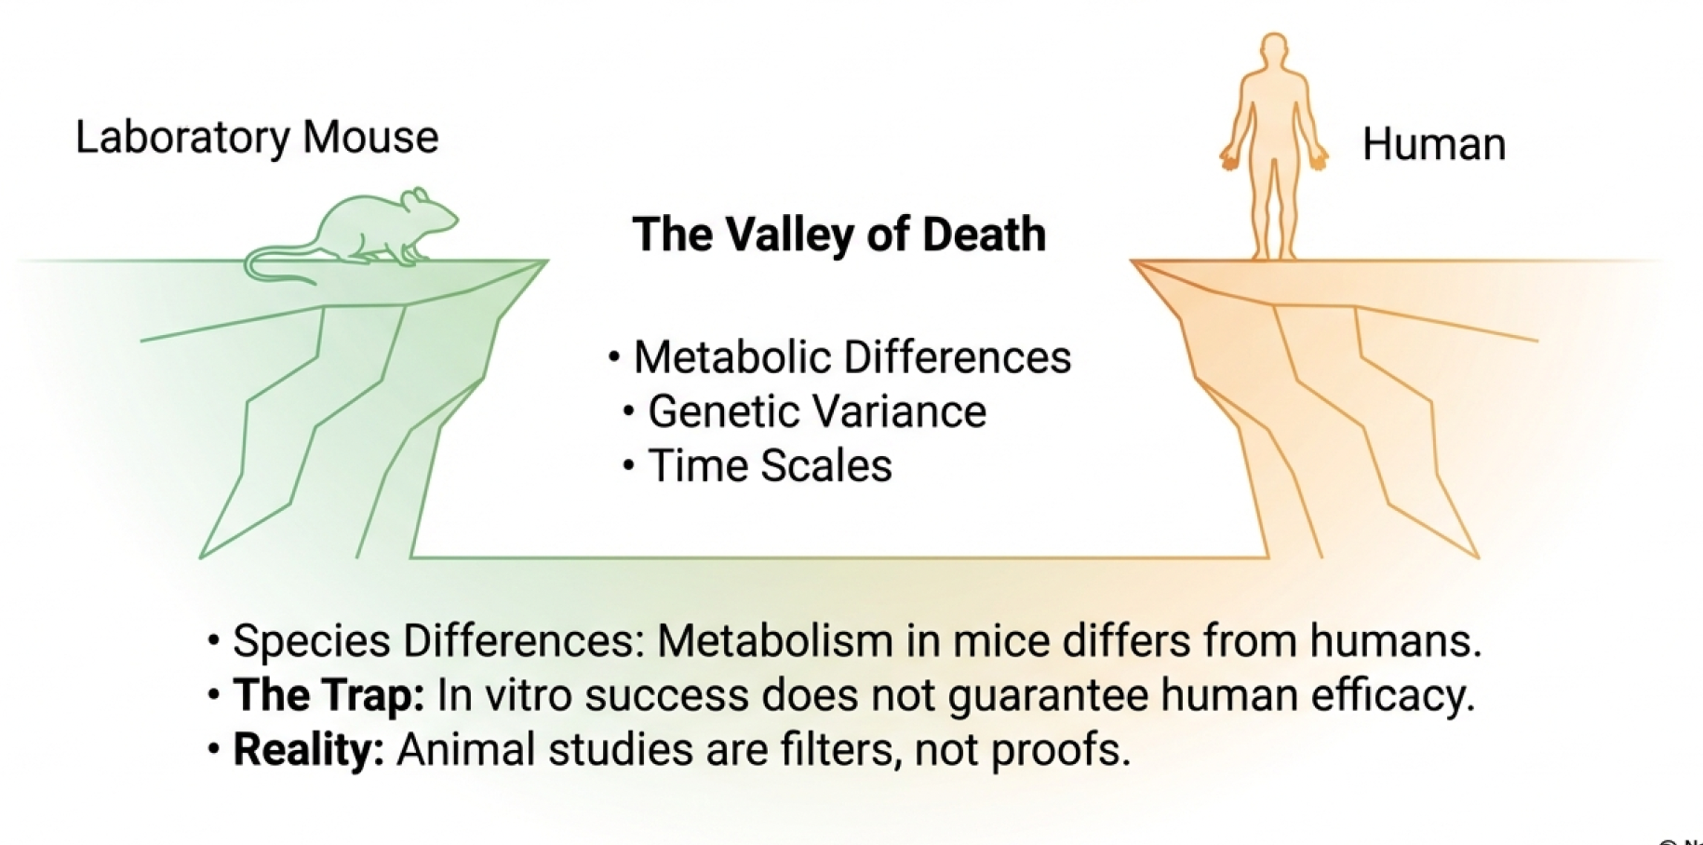
WHY ANIMAL MODELS FAIL

Slide 58
WHY ANIMAL MODELS FAIL
🧬 Different genetics and pathways
⚙️ Metabolism differs significantly
⏱️ Disease progression mismatch
📉 Translation failure is common

Slide 59
PRECLINICAL SAFETY AND TOXICOLOGY
☠️ Identify dose-limiting toxicity
🧪 Short- and long-term studies
🧠 Focus on organs at risk
⚠️ Rare effects often missed

Slide 60
DECISION GATES
🚪 Go / no-go decisions
📊 Integrate efficacy and safety
💰 High cost of wrong choice
⚠️ Bias and optimism creep in

Slide 61
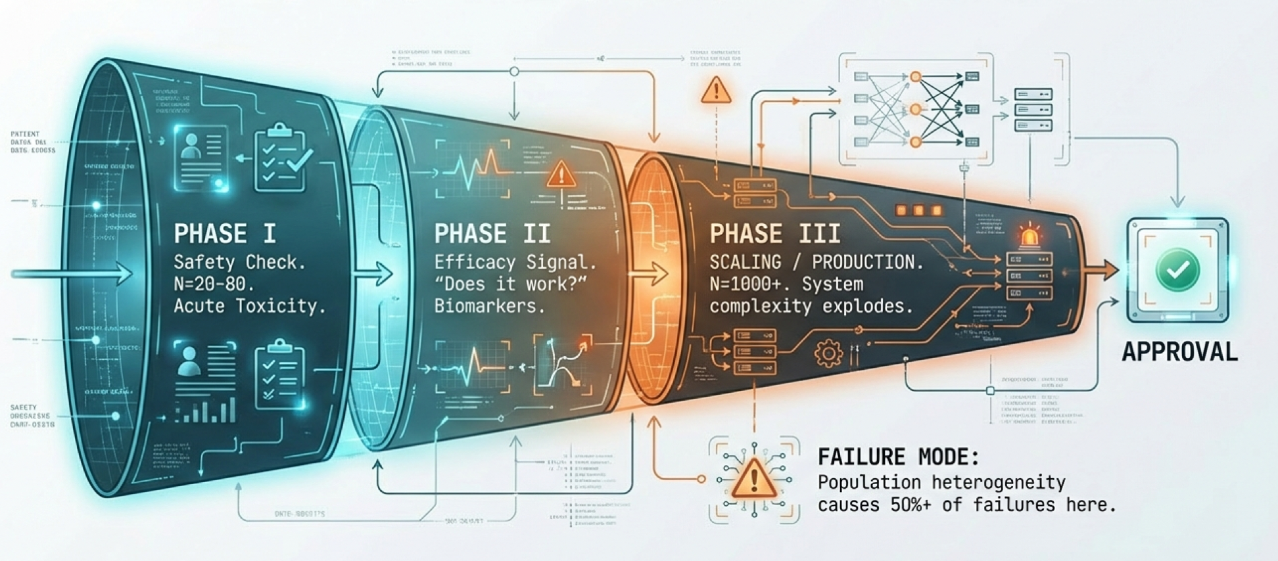
CLINICAL TRIALS AS SYSTEM VALIDATION

Slide 62
CLINICAL TRIALS AS SYSTEM VALIDATION
🧪 Test models against reality
🧠 Humans as the final system
📊 Controlled but limited setting
⚠️ Failure is informative

Slide 63
PHASE I: SAFETY, PK, & WARNING SIGNS
👥 Small number of volunteers
💊 Focus on dose and exposure
☠️ Identify acute toxicity
⚠️ Subtle signals are critical

Slide 64
PHASE II: EFFICACY, BIOMARKERS
🎯 Does the drug work?
🧬 Biomarkers guide decisions
👥 Patient subgroups emerge
⚠️ Many drugs fail here

Slide 65
PHASE III: SCALING FAILURE
📈 Thousands of patients
💰 Extremely expensive trials
⚠️ Small effects disappear
🧠 System-level complexity explodes

Slide 66
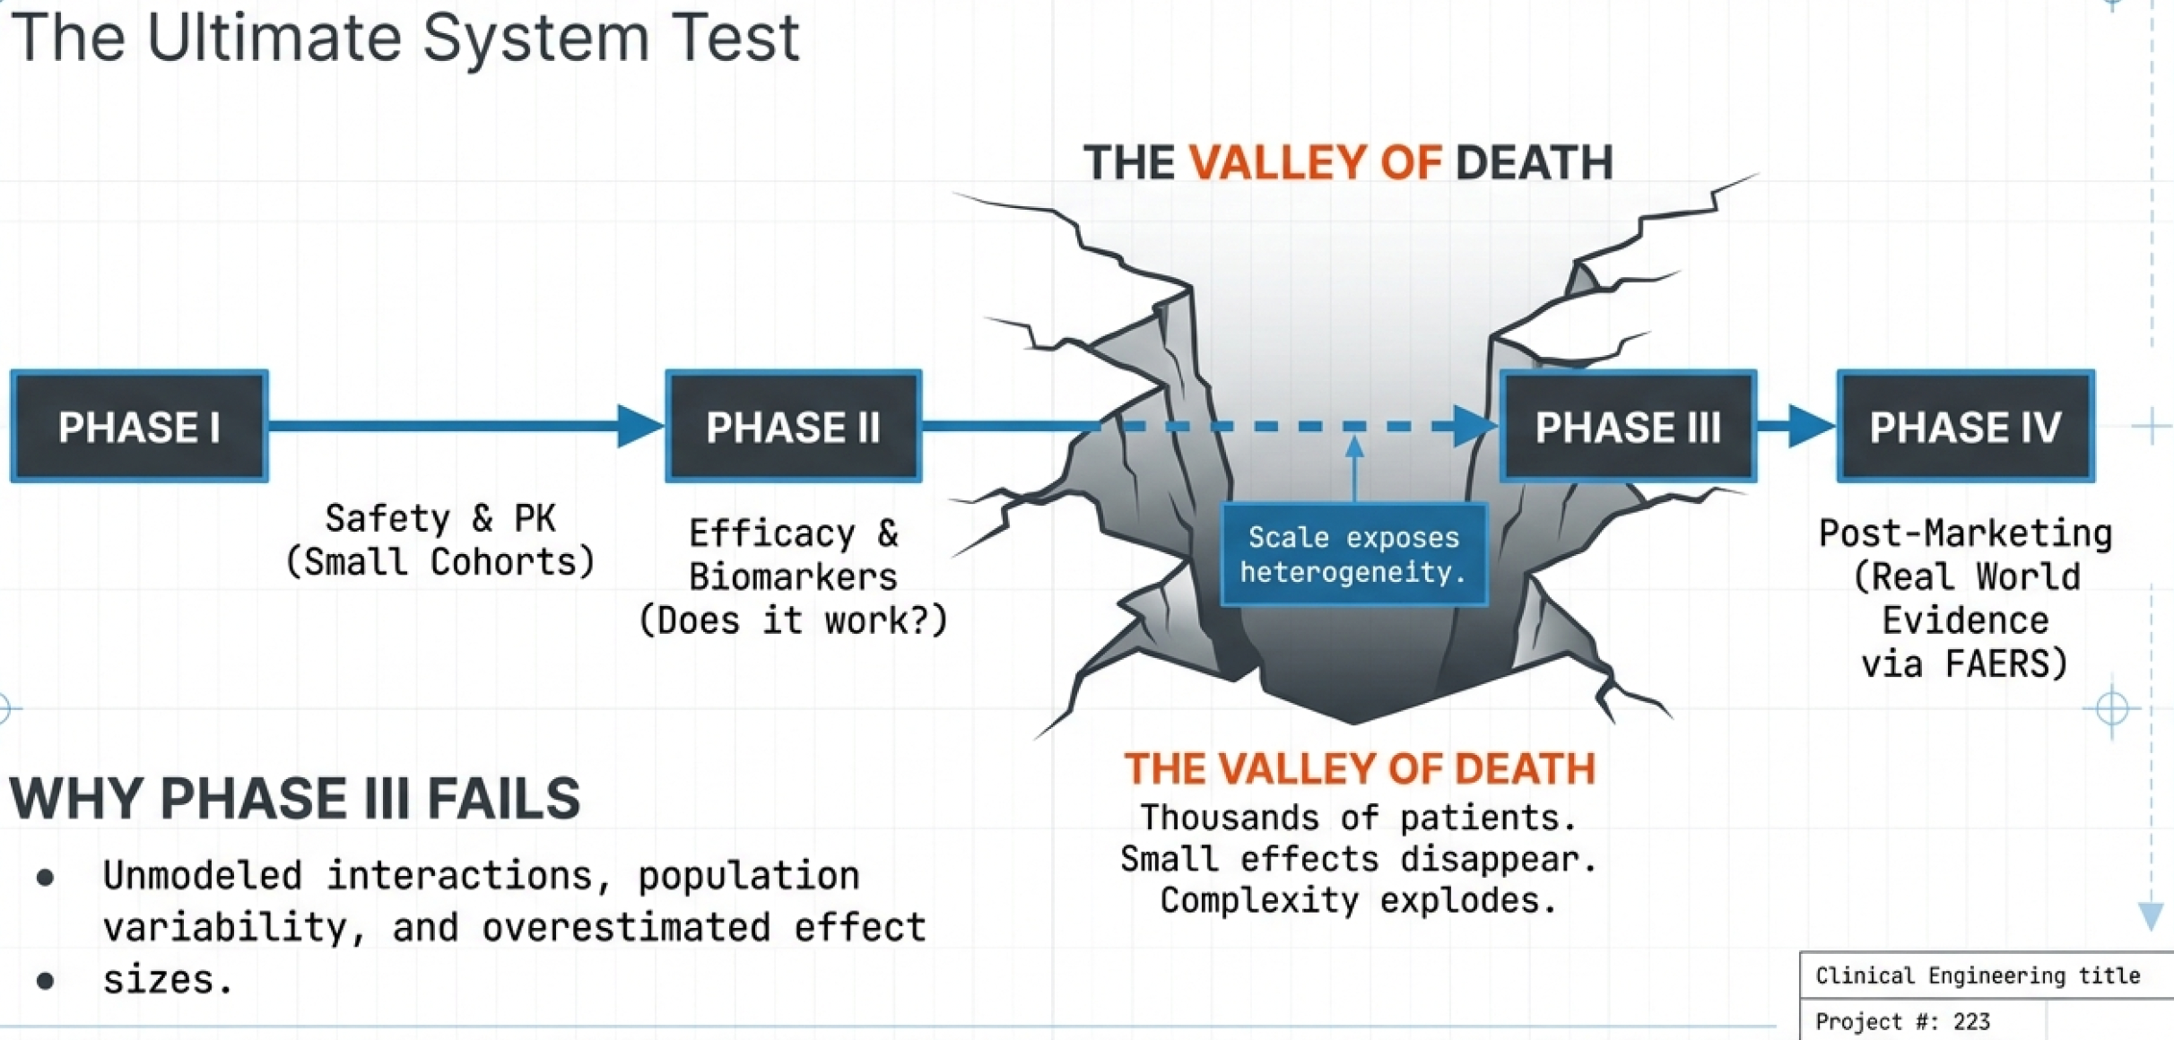
PHASE III: SCALING FAILURE

Slide 67
WHY PHASE III FAILS MOST OFTEN
👥 Population heterogeneity
🔄 Unmodeled interactions
📉 Overestimated effect sizes
⚠️ Late discovery of toxicity

Slide 68
PHASE IV: REAL-WORLD EVIDENCE
🌍 Use in uncontrolled settings
📊 Rare adverse events detected
🔄 Continuous model updating
⚠️ Problems may surface late

Slide 69
TOXICITY - A SYSTEMS-LEVEL PHENOMENON
☠️ Not always target-related
🕸️ Network and pathway disruption
⏱️ Effects accumulate over time
🧠 Hard to predict mechanistically

Slide 70
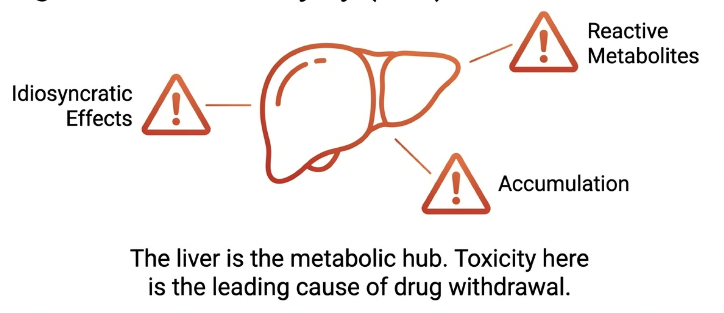
DRUG-INDUCED LIVER INJURY (DILI)

Slide 71
DRUG-INDUCED LIVER INJURY (DILI)
🧪 Liver is central to metabolism
☠️ Leading cause of drug withdrawal
⚠️ Often idiosyncratic
📉 Poorly predicted preclinically

Slide 72
LIVERTOX
📚 Curated clinical case reports
👥 Human-focused evidence
⚠️ Post-approval insights
🧠 Ground truth for DILI

Slide 73
B3DB - BIOACTIVITY-BASED SOURCE
🧪 Experimental bioactivity data
📊 Early toxicity signals
🧠 Useful for ML models
⚠️ Limited clinical relevance alone

Slide 74
KNOWN AOPS
🔗 Chain from molecular trigger to outcome
🧠 Causal structure matters
🧪 Used in regulatory toxicology
⚠️ Coverage is incomplete

Slide 75
TOXICITY AFTER LONG EXPOSURE
⏱️ Chronic use reveals hidden risks
🧬 Adaptive and compensatory effects
📉 Rare but severe outcomes
⚠️ Often missed in trials

Slide 76
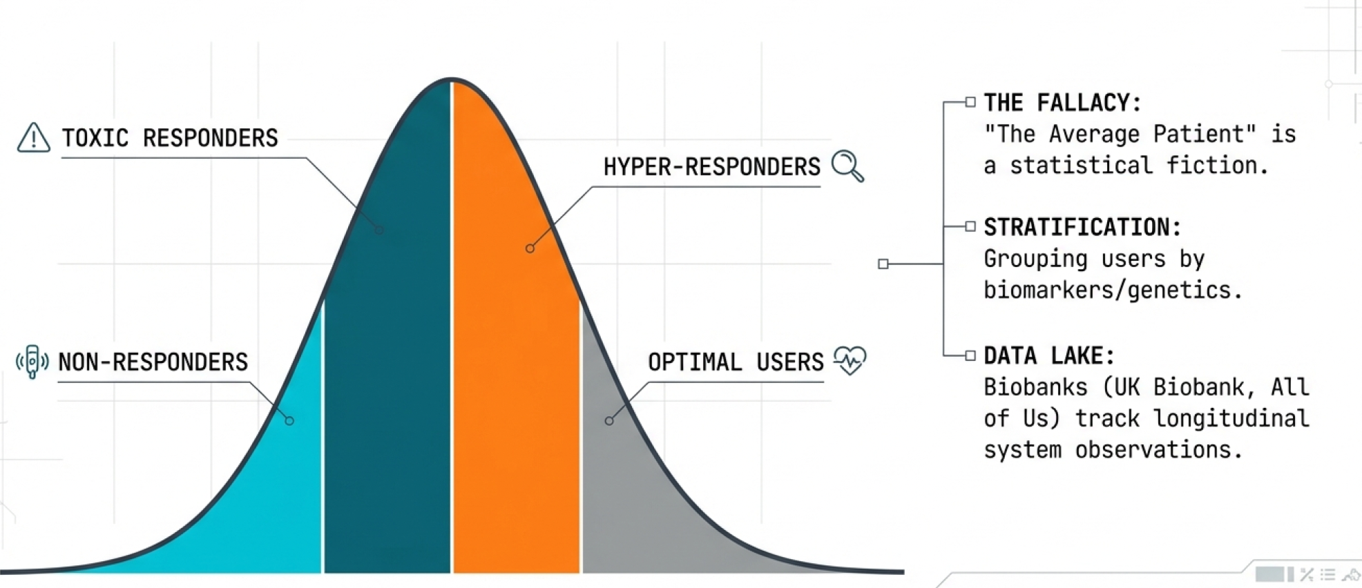
„AVERAGE PATIENT” DOES NOT EXIST

Slide 77
„AVERAGE PATIENT” DOES NOT EXIST
👥 Patients vary genetically and physiologically
⚖️ Same treatment can produce different outcomes
🧬 Personalized data improves predictions
⚠️ One-size-fits-all medicine fails

Slide 78
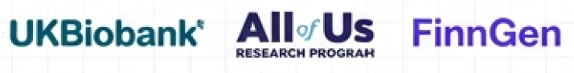
BIOBANKS
📚 Store genomic, proteomic, and clinical data
⏱️ Track patients over years
🧠 Enable retrospective and prospective studies

Slide 79
DISEASE HISTORY, COMORBIDITIES, RISK
🧪 Past diseases affect drug response
🔄 Interactions between comorbidities
📊 Risk stratification requires longitudinal data
⚠️ Ignoring history leads to failures

Slide 80
STRATIFICATION & ADAPTIVE TRIAL DESIGN
🎯 Patients grouped by biomarkers or genetics
🔄 Trials adapt based on emerging data
🧠 Improves efficiency and success rates
⚠️ Requires robust IT and modeling support

Slide 81
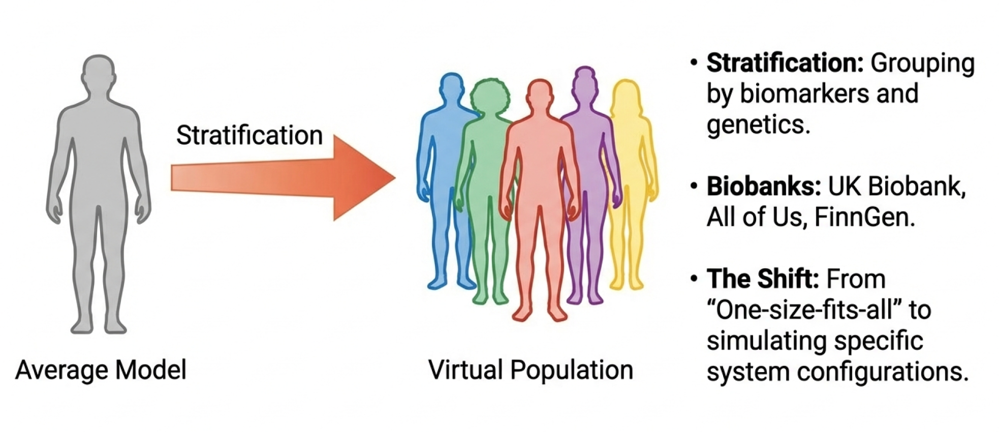
STRATIFICATION & ADAPTIVE TRIAL DESIGN

Slide 82
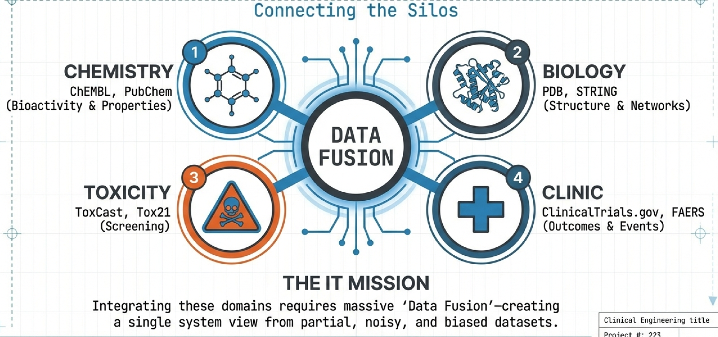

CHEMICAL AND BIOACTIVITY DATABASES

Slide 83
CHEMICAL AND BIOACTIVITY DATABASES
💊 ChEMBL: bioactivity of small molecules
🧪 PubChem: chemical structures and properties
📊 Useful for virtual screening and QSAR
⚠️ Data quality and curation matter

Slide 84
STRUCTURE AND INTERACTION DATA
🧬 PDB: 3D protein and ligand structures
🕸️ STRING: protein–protein interaction networks
🔗 Connects molecules to cellular pathways
⚠️ Coverage is incomplete

Slide 85
TOXICITY AND SAFETY DATA
☠️ High-throughput toxicity screening
🧪 Early prediction of adverse effects
📊 Supports ML and mechanistic models
⚠️ Limited direct clinical translation

Slide 86
CLINICAL DATA
📚 ClinicalTrials.gov: trial protocols and outcomes
⚠️ FAERS: post-marketing adverse events
🧠 Useful for real-world validation
🔄 Enables retrospective analyses

Slide 87
UK BIOBANK, ALL OF US, FINNGEN
🧬 Store genomics, proteomics, and clinical data
⏱️ Longitudinal patient follow-up
📊 Support personalized medicine research
⚠️ Population biases and access issues

Slide 88
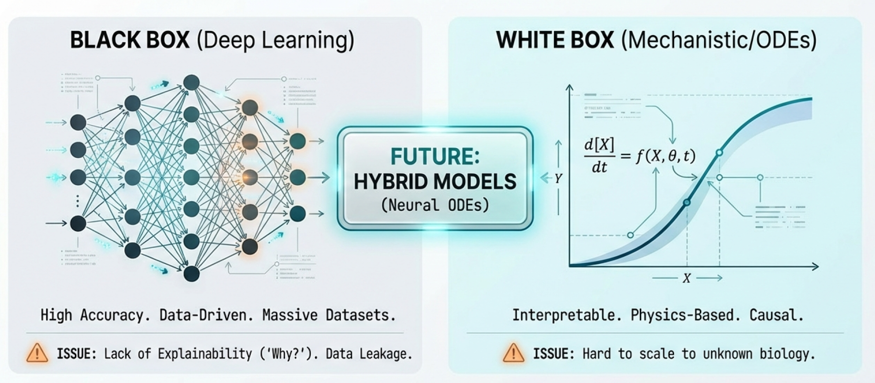
CLASSICAL MODELS VS MACHINE LEARNING

Slide 89
CLASSICAL MODELS VS MACHINE LEARNING
📐 Classical: mechanistic, interpretable
🤖 ML: data-driven, often black-box
⚖️ Trade-off: explainability vs accuracy
🧠 IT students design and integrate both

Slide 90
DEEP LEARNING IN DRUG DISCOVERY
🧠 Predict binding, ADME, toxicity
📊 Large datasets enable learning
⚠️ Overfitting and poor generalization
🔍 Regulatory acceptance limited

Slide 91
DILI PREDICTION MODELS
☠️ Rare events are hard to predict
🧪 Data sparsity limits accuracy
📉 Misclassified compounds can be toxic
⚠️ Mechanistic understanding still crucial

Slide 92
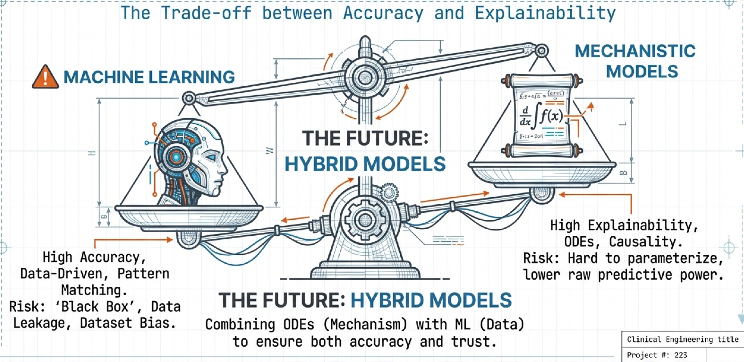
HYBRID MODELS: MECHANISTIC + ML

Slide 93
HYBRID MODELS: MECHANISTIC + ML
🔗 Combine ODEs and data-driven predictions
🧠 Exploit strengths of both approaches
⚖️ Balance accuracy with interpretability
🚀 Potential for personalized predictions

Slide 94
DATA LEAKAGE AND DATASET BIAS
⚠️ Information from test set in training
📊 Bias affects clinical relevance
🧠 Leads to false confidence in models
🔄 Proper validation is critical

Slide 95
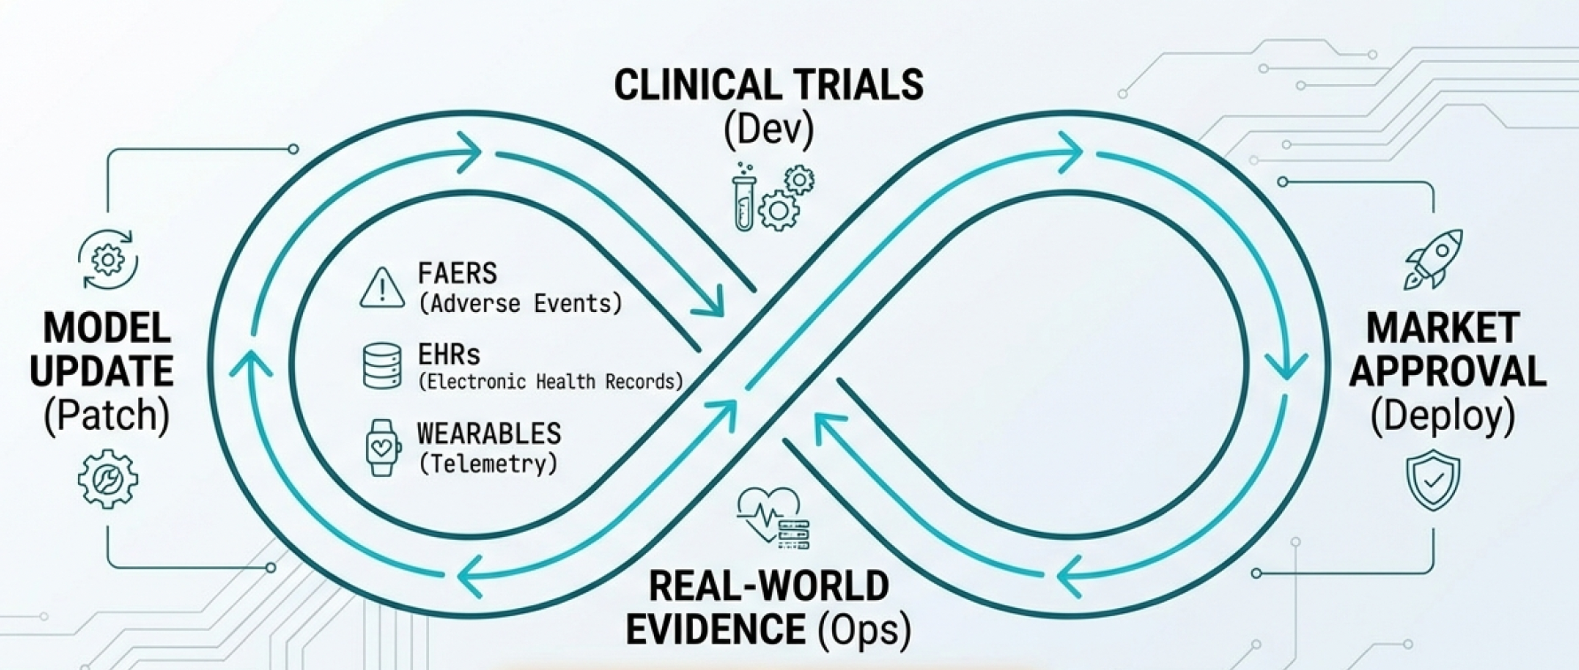
DATA LEAKAGE AND DATASET BIAS

Slide 96

CORRELATION VS CAUSALITY
📊 Correlated biomarkers are not causal
🧪 Many Phase II successes fail in Phase III
⚠️ Interventions break correlations
🧠 Causal modeling remains hard

Slide 97
EXPLAINABILITY VS ACCURACY
🤖 High accuracy is not enough
🔍 Regulators demand mechanistic insight
⚠️ Black-box failures are hard to debug
🧠 Trust requires interpretability

Slide 98
DISTRIBUTION SHIFT
📉 Trial populations are highly selected
👥 Real patients are older and sicker
⚠️ Models fail under new distributions
🔄 Post-marketing data reveals gaps

Slide 99
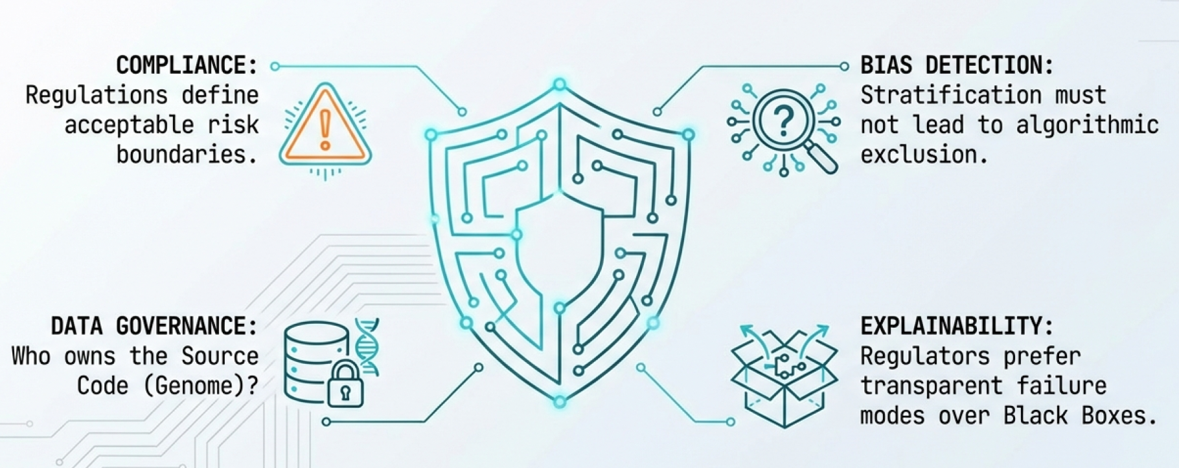
REGULATORY CONSTRAINTS

Slide 100
REGULATORY CONSTRAINTS
📜 Regulations define acceptable risk
⚖️ Models must support decisions
🧠 Validation is part of system design
⚠️ Innovation without compliance fails

Slide 101
REGULATORS PREFER SIMPLER MODELS
🔍 Simpler models are easier to audit
🧠 Failure modes are more transparent
⚠️ Complex ML lacks clear guarantees
⚖️ Trust outweighs marginal accuracy

Slide 102
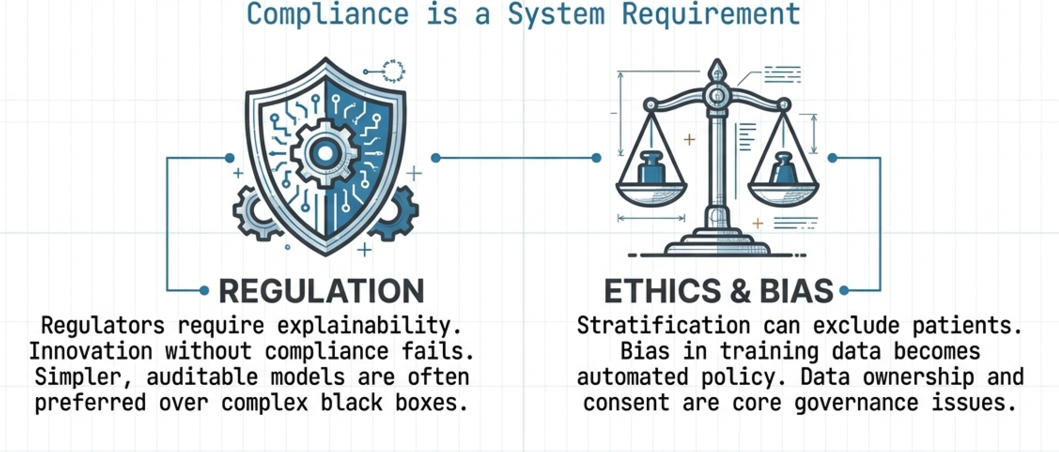
ETHICS OF PREDICTION

Slide 103
ETHICS OF PREDICTION
🎯 Stratification can exclude patients
⚠️ Predictions influence access to care
🧠 Bias becomes policy when automated
⚖️ Ethics must be designed in

Slide 104
OWNERSHIP AND USE OF BIOLOGICAL DATA
🧬 Biological data is deeply personal
📊 Who controls and profits from it?
⚠️ Consent is often broad and vague
🔐 Data governance is an IT problem

Slide 105

BIOINFORMATICS AS SYSTEMS ENGINEERING
🧠 Biology is a complex engineered system
🔧 Models, data, and feedback loops matter
📐 Failures propagate across scales
⚙️ Bioinformatics connects the layers

Slide 106
WHERE IT STUDENTS ADD THE MOST VALUE
💻 Data integration across silos
🤖 Robust modeling and validation
🔍 Detecting bias and leakage
📊 Turning data into decisions

Slide 107
REDUCING FAILURE AS THE REAL OBJECTIVE
📉 Most drugs fail late and expensively
🧠 Early prediction saves lives and money
⚠️ Preventing harm is success
🔄 Feedback beats optimization

Slide 108
FROM CODE TO PATIENTS
🧬 Every model affects real humans
⚖️ Responsibility grows with scale
🚀 IT enables safer, smarter medicine
❤️ Code can save lives

Slide 109
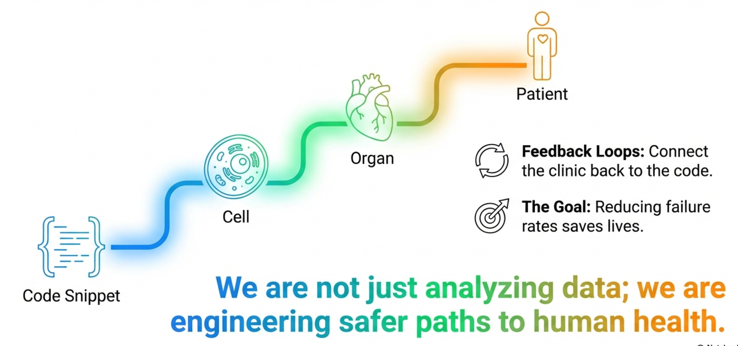
FROM CODE TO PATIENTS

Slide 111
THANK YOU

